Slide 1
Accumulation/Area & Volume
Alyssa, Camryn, Preetam

Slide 2
Class Work/Homework
Classwork:
Area & Volume
MC: All
FRQ: 11
Accumulations
MC: All
FRQ: 11 & 12
Homework:
Area & Volume
FRQ: 8 - 10
Accumulations
FRQ: 9, 10, 13

Slide 3
Card 42: Riemann Sums (Left, Right, Midpoint) and Trapezoidal Approximation Method
Δx_{n} represents the sub-interval widths...
Left: f(x₀)Δx₁ + f(x₁)Δx₂ + … + f(x_{n - 1})Δx_{n} (using value of f at the left endpoint) *tangent line is under approximation for increasing function
Right: f(x₀)Δx₁ + f(x₁)Δx₂ + … + f(x_{n - 1})Δx_{n} (using value of f at the right endpoint) *tangent line is over approximation for increasing function
Midpoint: f((x₀ + x₁)/2)Δx₁ + f((x₁ + x₂)/2)Δx₂ + … + f((x_{n - 1} + x_{n})/2)Δx_{n}
Trapezoidal: ½ [(f(x) + f(x))(Δx₁) + (f(x) + f(x))(Δx₁)] + … + ½ [(f(x) + f(x))(Δx₁)]

Slide 4
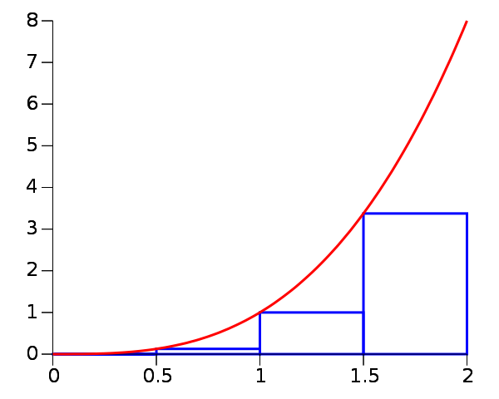
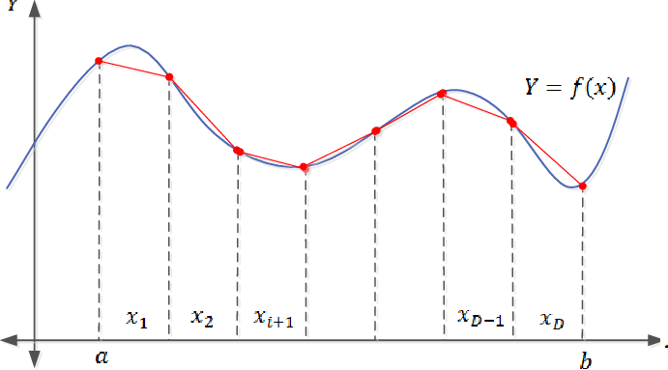
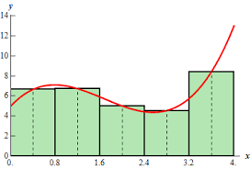
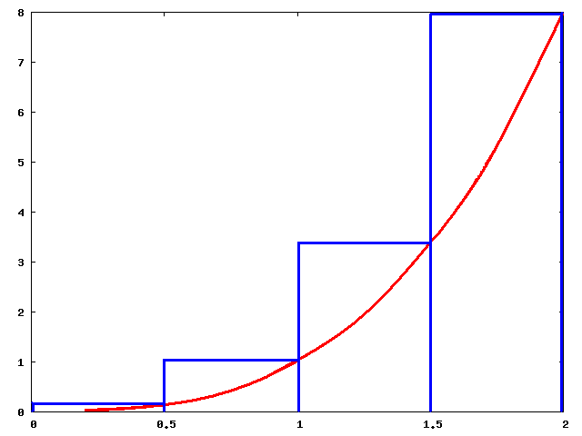
Riemann Sum Graphs

Slide 5
Card 43: Area Between Curves
When a and b are x-values, use the top function minus the bottom function
When a and b are y-values, use the right function minus the left function

Slide 6
Card 44: Volume with Disk/Washer Method
Disk Method
Washer Method
If the function is rotated around a horizontal line, use x-values for a and b, and make sure the functions are in terms of x
If the function is rotated around a vertical line, use y-values for a and b, and make sure the functions are in terms of y
When a and b are x-values, use the top function minus the bottom function
When a and b are y-values, use the right function minus the left function

Slide 7
Card 45: Volume with Cross-Sections
These formulas are in terms of a function perpendicular to the x-axis, if the function is perpendicular to the y-axis, use (right - left)
If perpendicular to the x-axis use dx (a and b should be x-values, and the top and bottom functions should be in terms of x)
IIf perpendicular to the y-axis use dy (a and b should be y-values, and the right and left functions should be in terms of y)

Slide 8
Card 46: Arc Length (Rectangular)

