Slide 1
Tangent Lines,
Linear Approximations,
& Theorems
Abby K., Aishwarya M., Daaniah S.
Bohrmann 2nd Period

Slide 2
Today in Review
Classwork:
Tangent Lines
MC #1-10
FRQ #14, 17
Theorems
MC #1-6
FRQ #13, 15
Homework:
Tangent Lines
MC #11-13
FRQ #15, 16
Theorems
MC #7-12
FRQ #14, 16, 17, 18

Slide 3
Card 18: Tangent Line/Normal Line (overestimate, underestimate)
Tangent Line: y-y₁ = m(x-x₁ )
Normal Line: (-1/m)
Find derivative (m) at given point and plug into the respective equation.
Plug in the (x₁, y₁) points into the equation
To make an approximation for a certain x value, substitute that value back into the tangent/normal equation.
If the function is concave down (f’’(x) < 0), then the tangent line is an over-approximation.
If the function is concave up (f’’(x) > 0), then the tangent line is an under-approximation.

Slide 4
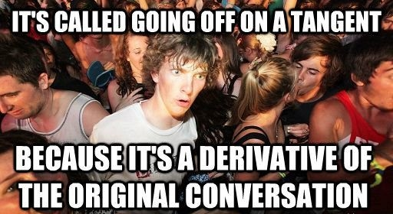

Slide 5
Card 19: Intermediate Value Theorem
Find f(a) and f(b)
Remember to state that the function is continuous on the interval [a,b].
Justify this “By IVT”

Slide 6
Card 20: Mean Value Theorem
Find
Establish that the function is differentiable on (a,b) and continuous on [a,b].
Justify this “By MVT”

Slide 7
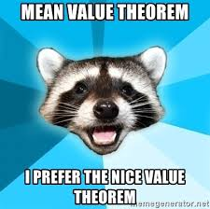
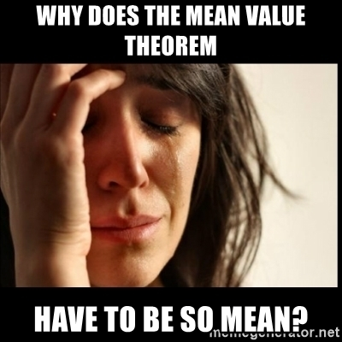

Slide 8
Multiple Choice Practice
Quizizz:
https://quizizz.com/admin/quiz/5ca2286380077f001a4436be

Slide 9
FRQ Practice
Tangent Line Approximations

Slide 10
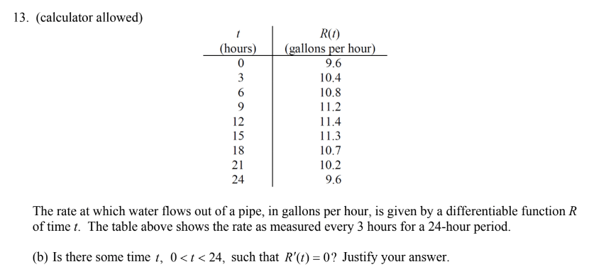
FRQ Practice
Theorems

Slide 11
FRQ Practice
Tangent Line Approximations

Slide 12
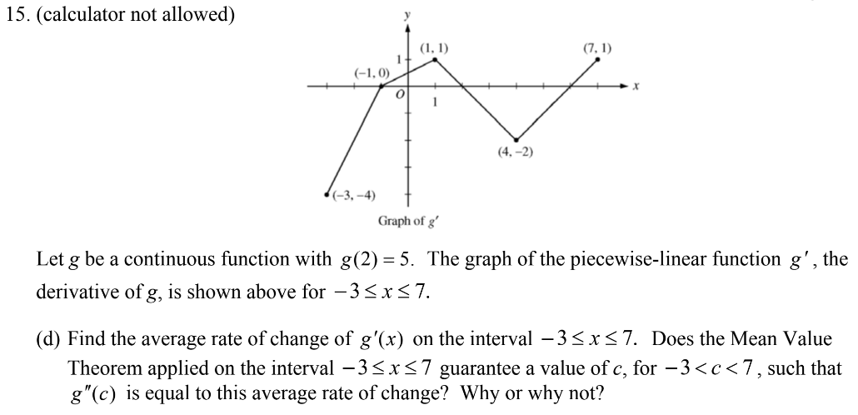
FRQ Practice
Theorems

Slide 13
The End

Slide 14
Links (if needed)
Tangent Lines
https://www.dropbox.com/sh/hoqexfkcfug5ts0/AADvdg4_4fUSpbzccNyJ5szUa/3%20Tangent%20Lines%20and%20Linear%20Approximations%20SSS%20Handouts.pdf?dl=0
https://www.dropbox.com/sh/hoqexfkcfug5ts0/AACxqyqimf22UUxREJ8RHGQFa?dl=0&preview=3+Tangent+Lines+and+Linear+Approximations+SSS+Solutions.pdf
Theorems
https://www.dropbox.com/sh/hoqexfkcfug5ts0/AACxqyqimf22UUxREJ8RHGQFa?dl=0&preview=3+Theorems+SSS+Handout.pdf
https://www.dropbox.com/sh/hoqexfkcfug5ts0/AACxqyqimf22UUxREJ8RHGQFa?dl=0&preview=3+Theorems+SSS+Solutions.pdf

