Slide 1
Slope Fields and Differential Equations
By Charlie Chun and Tiffany Kwok

Slide 2
47. Steps for Solving a Differential Equation with Separation of Variables
Step 1: Move all your “y”s to one side and all your “x”s to the other
Ex: dy/dx= 2x dy=2xdx
Step 2: Take the integral of both sides (Don’t forget your cookies)
Ex: ∫dy=∫2xdx y=x + c
Step 3: If given the initial condition then substitute it in to find “c”
Ex: Initial condition: (0,2)
2=(0) +c c=2 y=x +2
Step 4: Solve for y
Ex: y=x +2
2
2
2
2

Slide 3
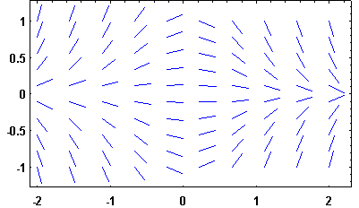
48. Slope Fields
Take the derivative of f(x) at each point
Graph it

Slide 4
Homework
#1,3,4,10,12,13,15

Slide 5
Quizizz
https://quizizz.com/admin/quiz/5cae429ddeeead001bea97ee

