Slide 1
Diff-Eqs and Slope Fields
Taran, Matthew, Tony

Slide 2
Assignments
In Class:
All MC
FRQ #12,15
Homework:
FRQs #11,13,14

Slide 3
47 - Steps for Solving a Diff-Eq with Separation of Variables
Separate the variables by putting all y variables on one side of the equation and all x variables on the other side.
Integrate both sides (don’t forget to add C).
Solve for C using information from the problem (a point may be given to solve for C)
Solve for y

Slide 4
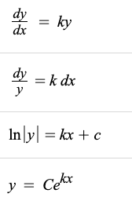
Separate variables
Integrate
Solve for y

Slide 5
48 - Slope Fields
Slope Field - The slope field is defined as the collection of small line segments passing through various points having a slope that will satisfy the given differential equation at that point.
Steps:
Find differential equation for slope field (dy/dx)
Plug in x & y values into dy/dx
Sketch the slopes at the given (x, y) points

Slide 6
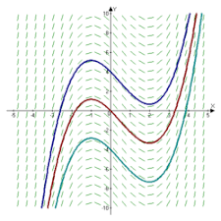
Slope Fields Visual

Slide 7
FRQ Practice
QR Code:

Slide 8
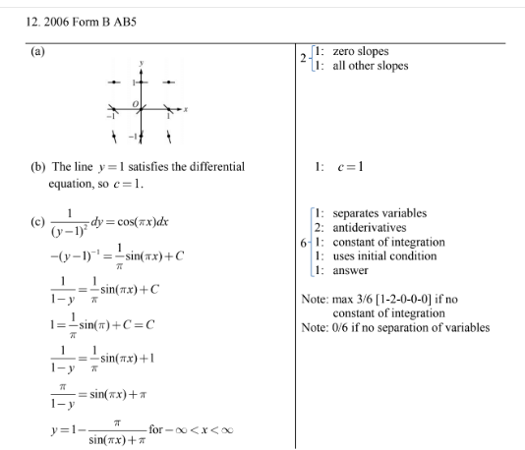

Slide 9
