Slide 1
Polar
Emi, Grace, Susan

Slide 2
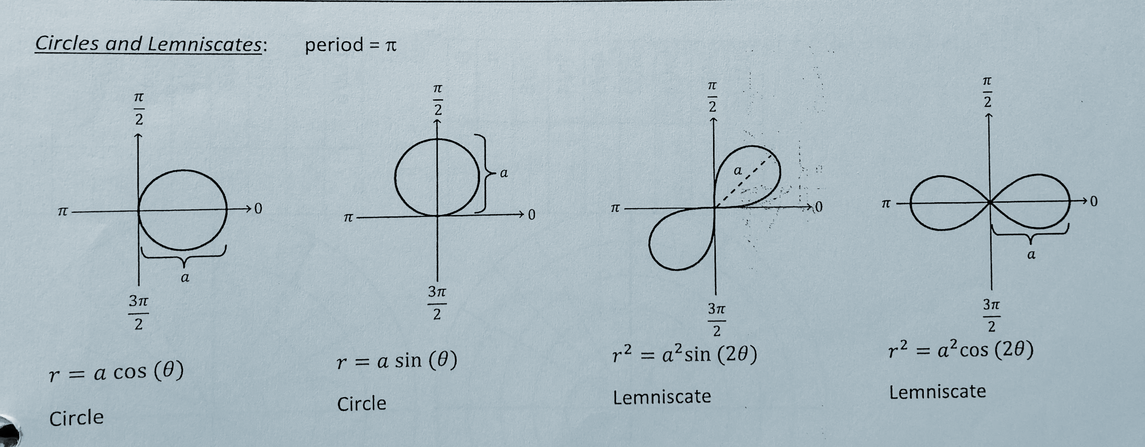
Card 69: Common Polar Graphs/Equations (1/3)

Slide 3
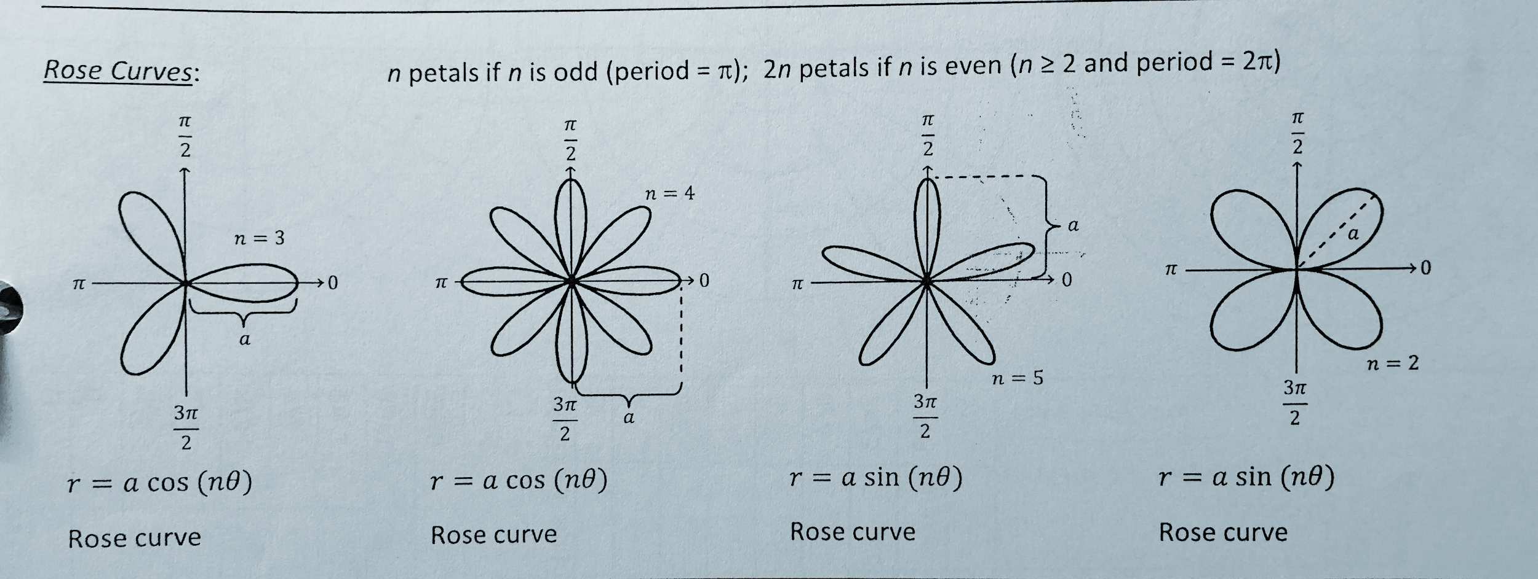
Card 69: Common Polar Graphs/Equations (2/3)
n petals if n is odd, 2n petals if n is even

Slide 4
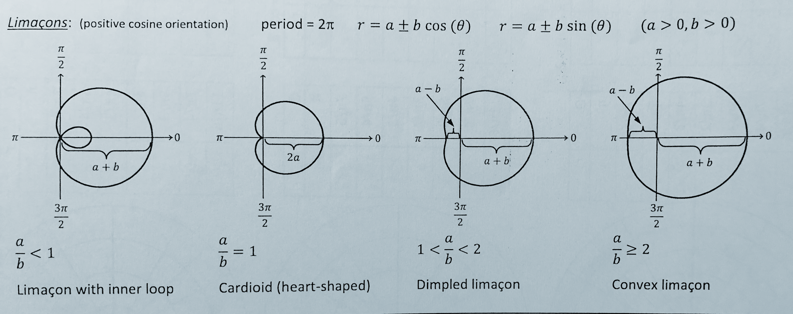
Card 69: Common Polar Graphs/Equations (3/3)

Slide 5
Card 70: Polar Conversion Formulas
x²+y²=r² or r=√(x²+y²)
y=rsin𝛳 or sin𝛳=y/r
x=rcos𝛳 or cos𝛳=x/r
tan𝛳=y/x or 𝛳=tan⁻¹(y/x)

Slide 6
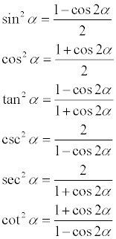
Card 71: Power Reducing Identities

Slide 7
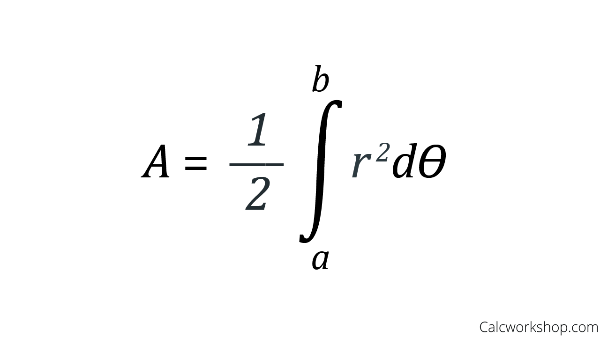
Card 72: Finding Polar Area

Slide 8
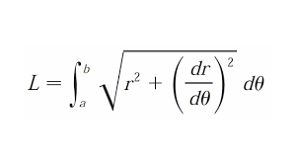
Card 73: Arc Length (Polar)

Slide 9
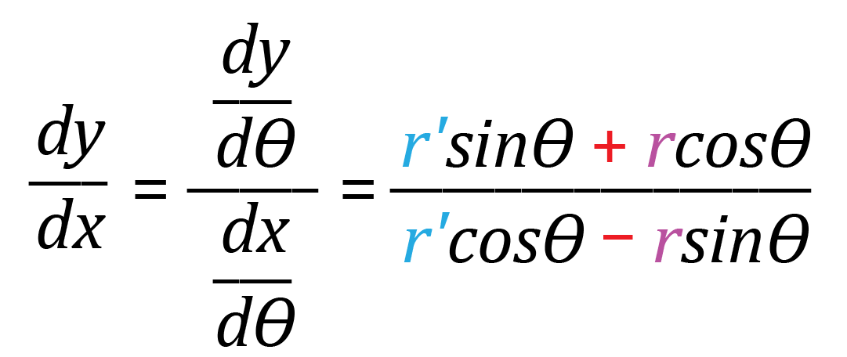
Card 74: Finding dy/dx (Polar)
*don’t forget product rule!

Slide 10
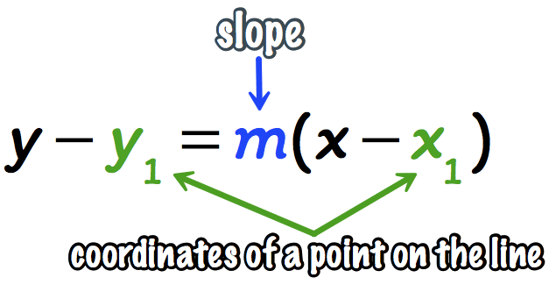
Card 75: Tangent Line (Polar)
Find the slope at the given 𝜃, using the formula:
Find r and r ’
Plug in given 𝜃 into r and r’
Plug values of r and r’ into the slope formula above
Solve for slope
Plug the slope and point at 𝜃 into the point slope form of a tangent line:

Slide 11
Card 76: Interpreting Motion (Polar)
Particle motion in polar is determined by the rate of the r(𝜃) function:
If > 0 then the particle is moving away from the origin
If < 0 then the particle is moving towards the pole (origin)
If = 0 then the particle’s position MAY be at a maximum distance from
the pole (origin) **particle’s distance from the origin is not changing**
**the curve is moving away from the origin; r is increasing (when asked about r or the curve)
**the curve is approaching the origin; r is decreasing

Slide 12
Homework:
Polar Packet:
MC: #8
FRQ: #10

