Slide 1
Parametrics & Vectors
By: Ashika, Rithika, and Sruthi

Slide 2
What is a Parametric Function?

Slide 3
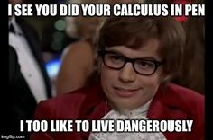
HOMEWORK
FRQs: #10, #11, #12, no mc:)
From the BC Review Packet (Parametrics & Vectors)

Slide 4
77. ARC LENGTH
Determined through one formula:

Slide 5
78. SPEED, AVERAGE SPEED, TOTAL DISTANCE TRAVELED
To find speed, use:
To find average speed, use:
To find the total distance traveled, use:

Slide 6
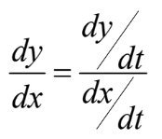
79. FINDING DY/DX and D^2Y/DX^2
To Find dy/dx:
Use:
To find d^2y/dx^2:
Use:

Slide 7
80. INTERPRETING MOTION PT.1
dy/dx:
If dy/dx > 0, the curve is increasing
If dy/dx < 0, the curve is decreasing
If dy/dx = 0, there could be a relative maximum or minimum on the curve
If dy/dx = 0, there is a horizontal tangent
If dy/dx is undefined, there is a vertical tangent

Slide 8
80. INTERPRETING MOTION PT. 2
dy/dt:
If dy/dt > 0, the particle is moving up
If dy/dt < 0, the particle is moving down
If dy/dt = 0, and dx/dt ≠ 0, there is a horizontal tangent
dx/dt:
If dx/dt > 0, the particle is moving to the right
If dx/dt < 0, the particle is moving to the left
If dx/dt = 0, and dy/dt ≠ 0, there is a vertical tangent

Slide 9
Thanks For Watching!

